Slide 1
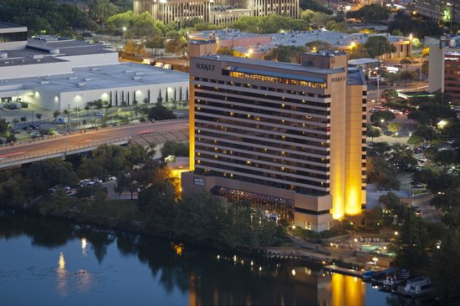
IST 687
Let’s make Hyatt Great Again
Done By:
Anmol Handa
Kushab Thakar
Shreyas Sambamurthy
Tanay Pardeshi

Slide 2
Problem STATEMENT
Hyatt has chains all around the world.
Customers from varying demographics and age visit different brands of Hyatt for different purposes.
Hyatt aims at increasing the number of Promoters.
Hyatt is looking for suggestions to improve their customer experience.

Slide 3
Business question 1:
Why was analysis confined to guests staying at Hyatt group of hotels in the United States and why was it further boiled down to Texas?

Slide 4
BUSINESS QUESTION 2
Which class and category of guests constitute the major source of revenue for Hyatt group of hotels within the United States?

Slide 5
BUSINESS QUESTION 3
Why Hyatt Regency needs special focus amongst other Hyatt brands?

Slide 6
BUSINESS QUESTION 4
What are the key factors that affect the NPS of Hyatt group of hotels among the 237 variables in the dataset?

Slide 7
Use of descriptive statistics
Analysis was confined to the United States since it houses a major portion of guests at Hyatt group of hotels.
Texas was taken under spotlight since analysis showed that there were discontinuities in the net promoter score of Texas during winter.
Hyatt Regency, which had the major percentage of customer acquisition but a staggering recommendations from customers was pulled for further granularity.
Analysis revealed the importance of few attributes like Customer Service, Hotel Condition, Customer’s Age and Golf Course Reachability were major factors in deciding promoters and detractors

Slide 8
WHY UNITED STATES

Slide 9
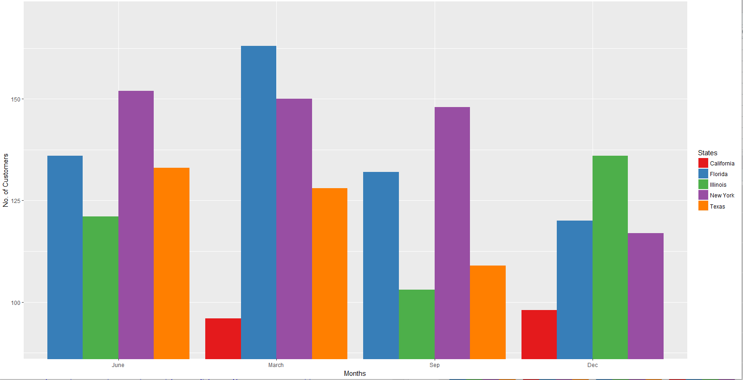

Slide 10
WHY TEXAS

Slide 11
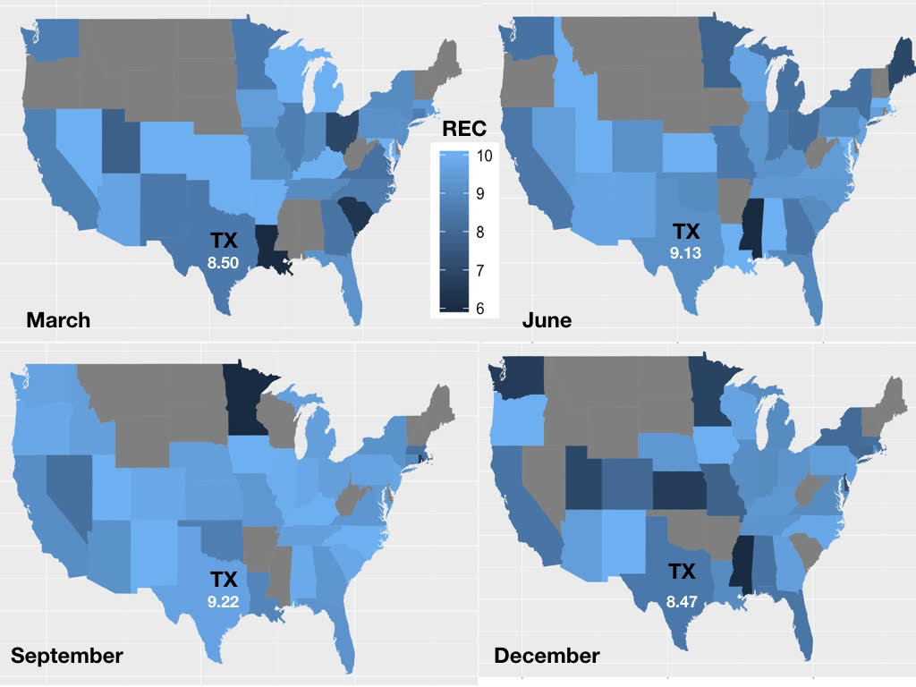

Slide 12
Why Hyatt regency

Slide 13
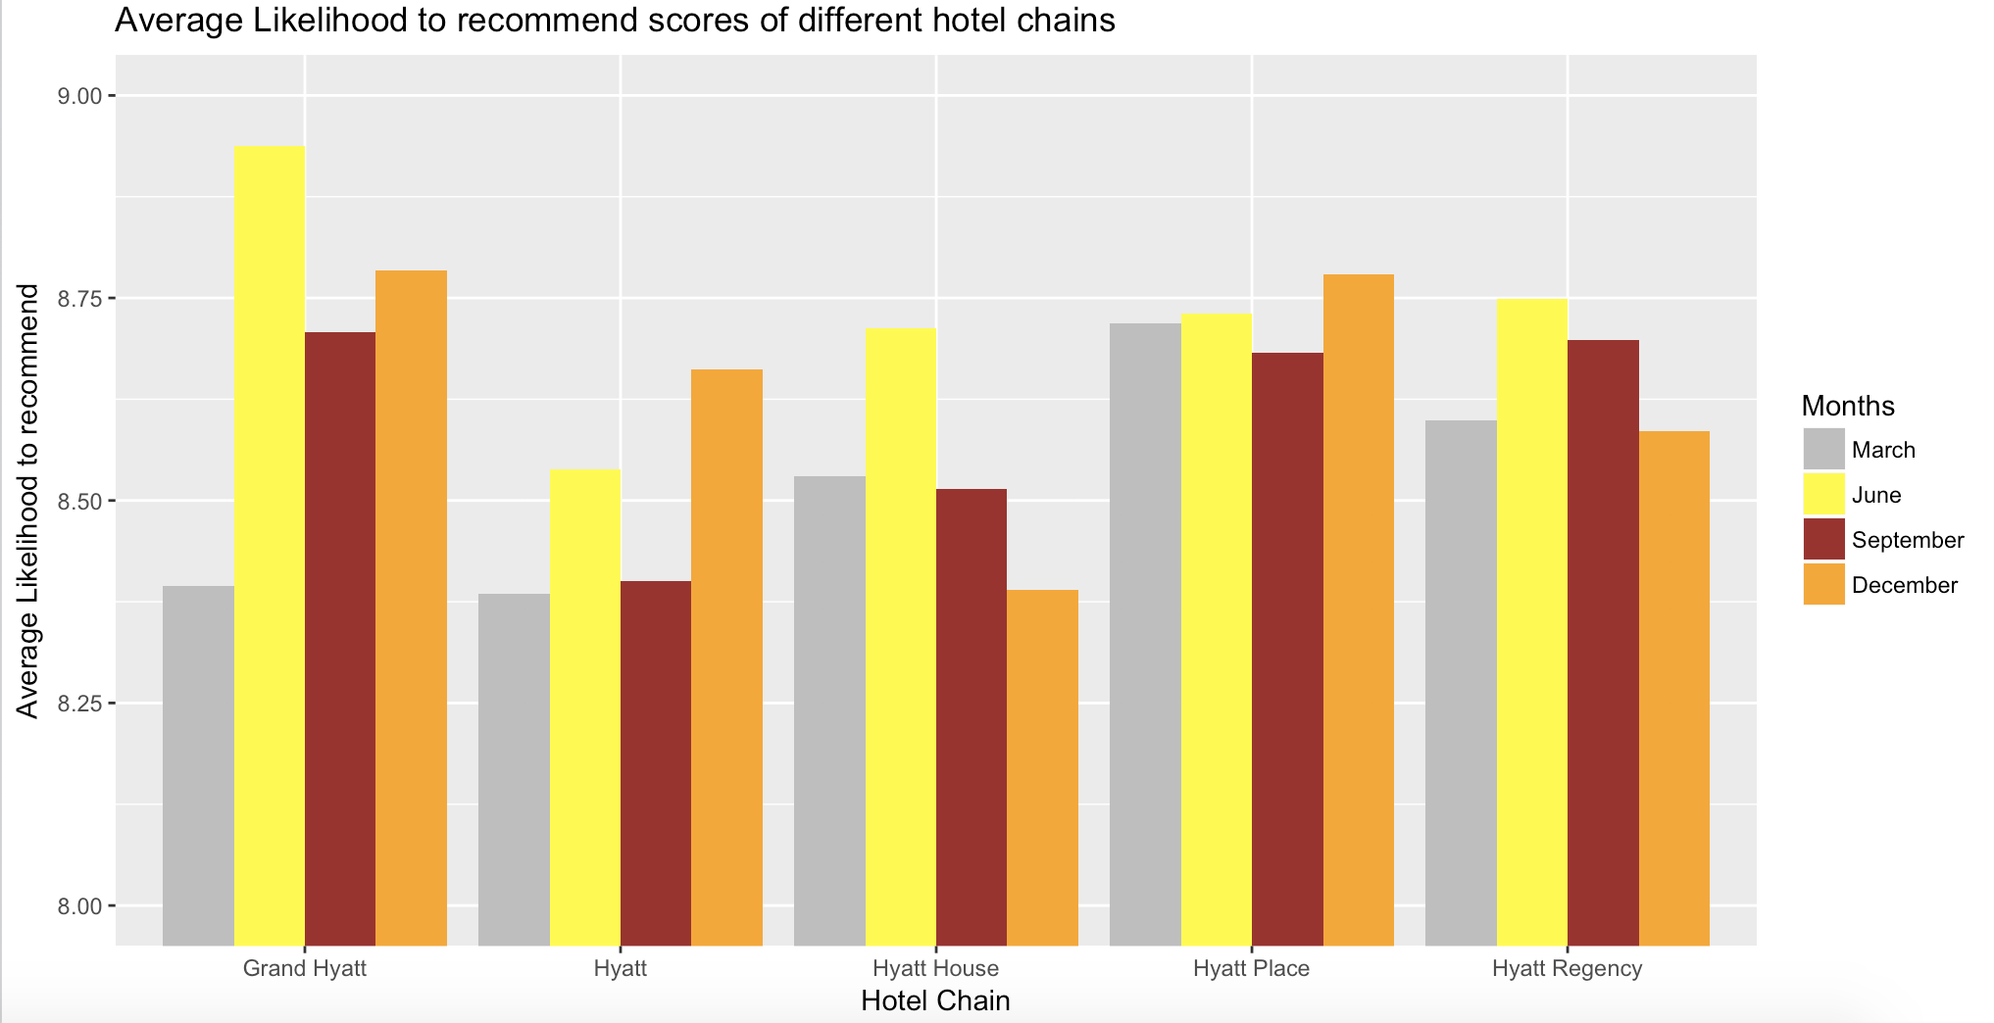
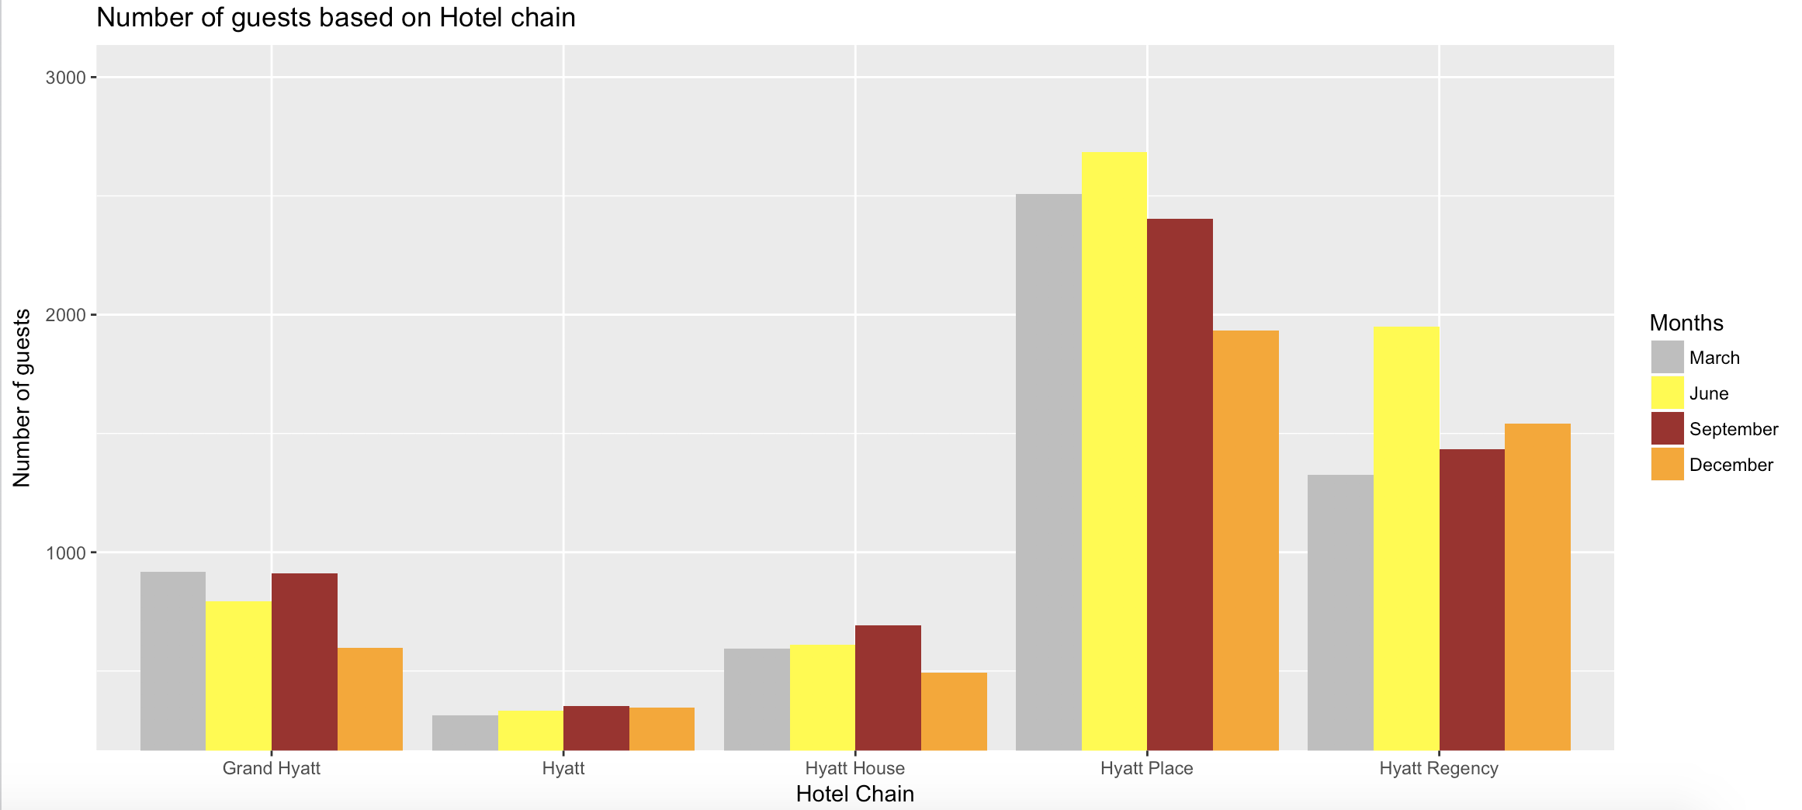

Slide 14
USE OF DESCRIPTIVE STATISTICS CONTD
Average Revenue per customer for both Business and Leisure guests were calculated
Total Revenue for both Business and Leisure Customer were explored.
Apart from that, the frequency of customers staying for Business or Leisure was analyzed
This led to the conclusion that a major chunk of their revenue and frequency is from Business travelers who were equally distributed across both the genders, most of whom were in the age group from 36 to 65.

Slide 15
Frequency of guests vs total revenue

Slide 16
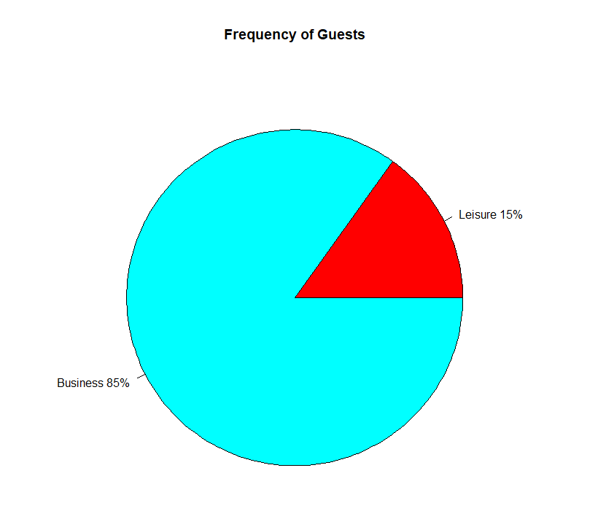
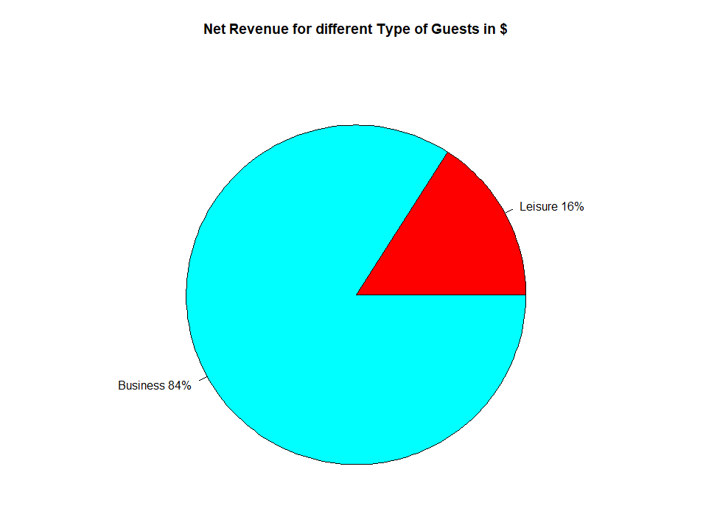

Slide 17
NUMBER OF GUESTS VS AGE GROUPS

Slide 18
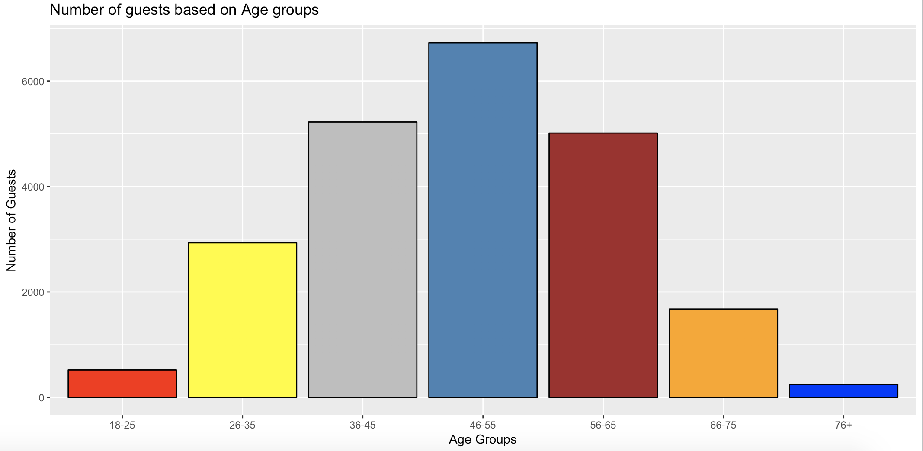

Slide 19
USE OF DESCRIPTIVE STATISTICS CONTD..
Guest country was not considered since it did not contribute to the analysis.
Attributes like business center availability, dry cleaning services and resort facility, limo and laundry services were not important for analysis, hence removed.
Golf facility and self parking were essential as they impact the net promoter score.
Internet does not contribute much to the analysis

Slide 20
internet

Slide 21
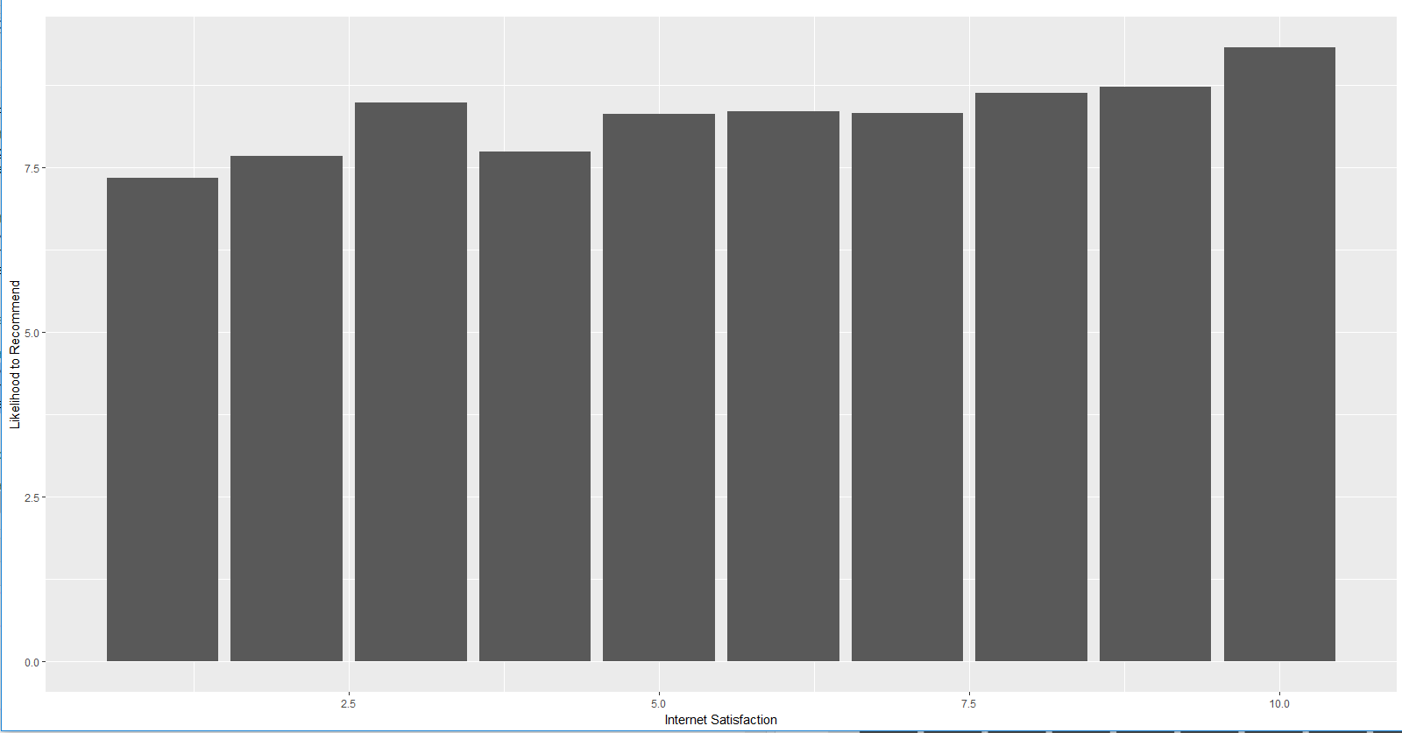

Slide 22
Use of modelling techniques
All four modelling techniques were used to predict the likelihood to recommend of customers.
Naïve Bayes model led to near accurate prediction of the likelihood to recommend values.
Twenty different attributes were taken into consideration while predicted the value of likelihood to recommend
The error percentage of this prediction was just 4.4%
The error percentage of ksvm and svm were around 20%.

Slide 23
Actionable insights
Golf and Self Parking facilities play a major role in determining detractors.
Using linear modelling with a few attributes, we got to know that hotel condition, customer service, tranquility and guest room conditions had a direct impact in determining the detractors and promoters.
Business guests between the age of 36-65 have to be their primary focus.

Slide 24
Golf and self parking

Slide 25
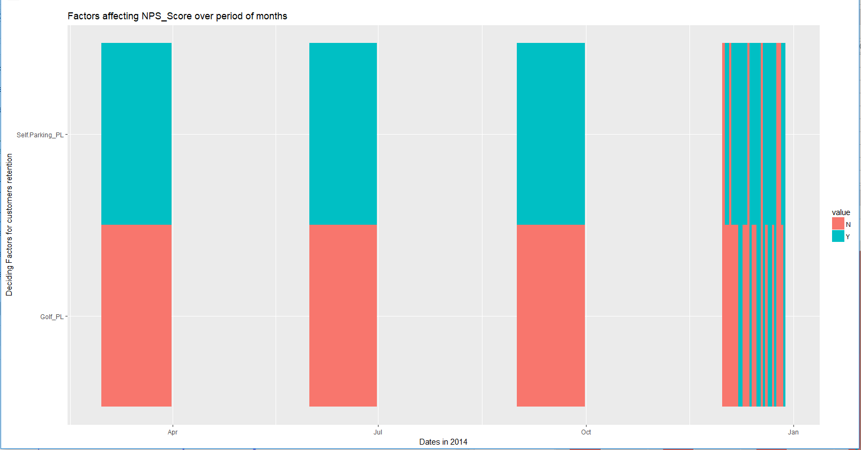

Slide 26
tranquility

Slide 27
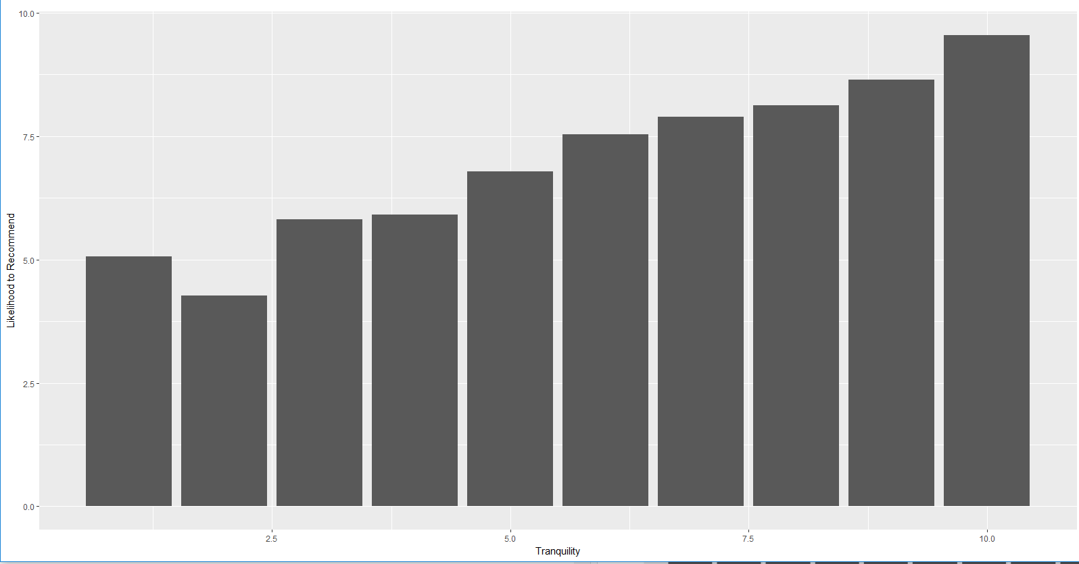

Slide 28
validation
Association rules validated the major attributes responsible for detractors (guest room, customer service and hotel condition)
Apriori shows that customers in the age range of 46-65 are promoters as well as high in number which leaves us with the conclusion that more emphasis has to be laid on business guests in the age range of 36-46.
Visualization indicates that with better hotel condition and tranquility, likelihood to recommend increases exponentially.
Staff Cared is another field that has a direct impact on Likelihood to recommend

